Slide 1
internship
Mentorness
Task-2 Batch Name: MIP-ML-16
Sales Forecasting for Furniture Store
By: Gautam Kumar maurya
Notes:
NOTE:
To change the image on this slide, select the picture and delete it. Then click the Pictures icon in the placeholder to insert your own image.

Slide 2
Time Series Forecasting Problem
To build the model we should perform the 4steps
Data Preprocessing and visualization
Augmented Dicky-Fuller test
Selecting algorithm and model building
Test the model and predict the future sales

Slide 3
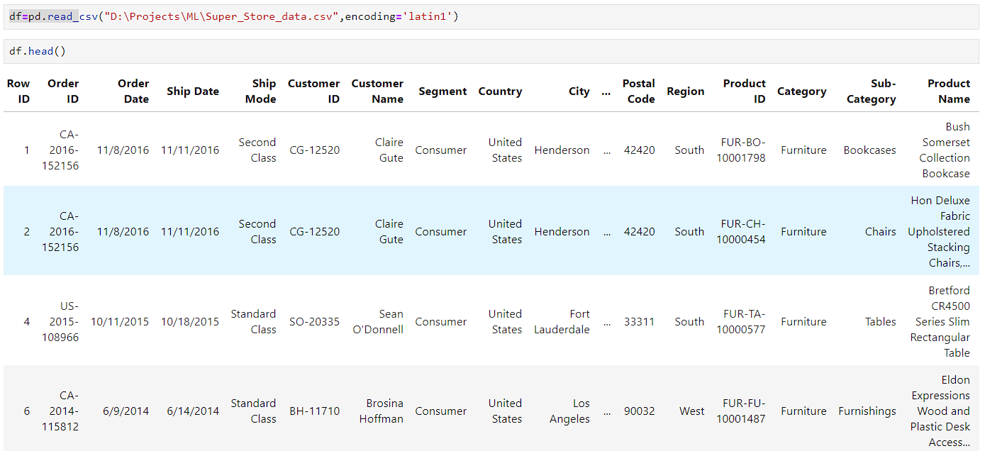
Step - 1
Data preprocessing and visualization
Read data set using pandas read_csv fumtion
1.The data has 2121 entry
2.The given data has no null values
3.The data has no duplicate rows

Slide 4
Data Preprocessing
The columns in store data set
['Row ID', 'Order ID', 'Order Date', 'Ship Date', 'Ship Mode', 'Customer ID', 'Customer Name', 'Segment', 'Country', 'City', 'State', 'Postal Code', 'Region', 'Product ID', 'Category', 'Sub-Category', 'Product Name', 'Sales', 'Quantity', 'Discount', 'Profit']
we are going to prepare a model that will predict the future so that we need only "Order date" and "Sales" on that particular date that's why we remove all other columns from the data set
Now we have only two columns “Order Date” and ”Sales”
Now convert the date into monthly and same way Sales also

Slide 5
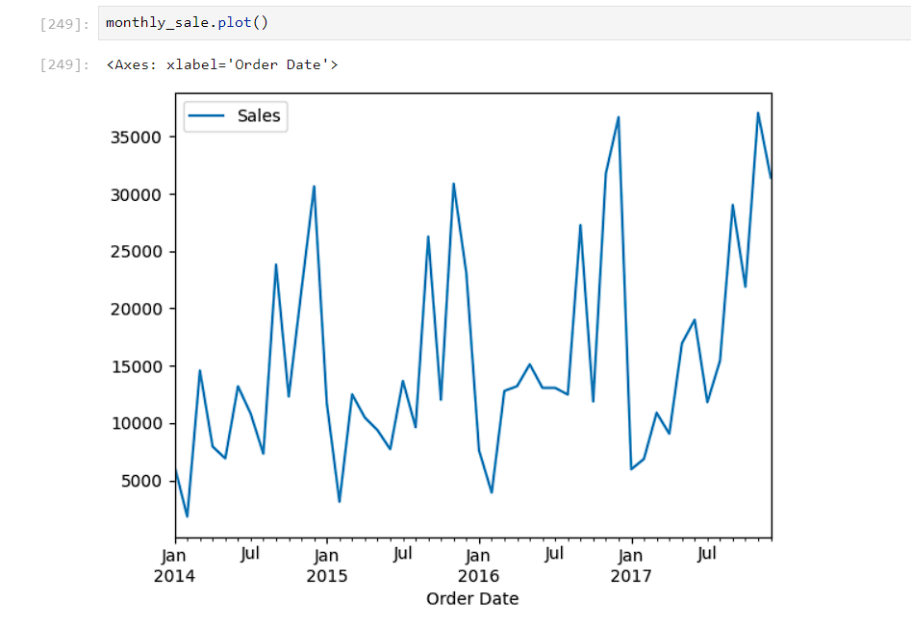
Data Visulization
We can see that the data is in seasonal format.

Slide 6
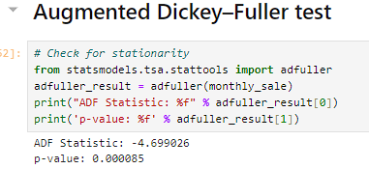
Step – 2 Augmented Dickey–Fuller test
Checking null hypothesis
(H0) and (H1)
Because the P-vale < 0.05
It show that data is satationary
The Augmented Dickey-Fuller (ADF) test statistic of -4.697056 with a p-value of 0.000085 suggests strong evidence against the null hypothesis (H0), leading to the rejection of the null hypothesis. This indicates that the data has no unit root and is stationary, implying that it does not exhibit a trend and its statistical properties remain constant over time.

Slide 7
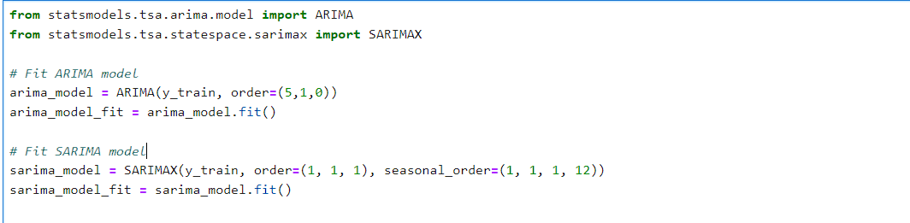
Step – 3: Selecting algorithm and model building
For model building, we use two algorithms and train and test them
1. ARIMA model
2. SARIMA model

Slide 8
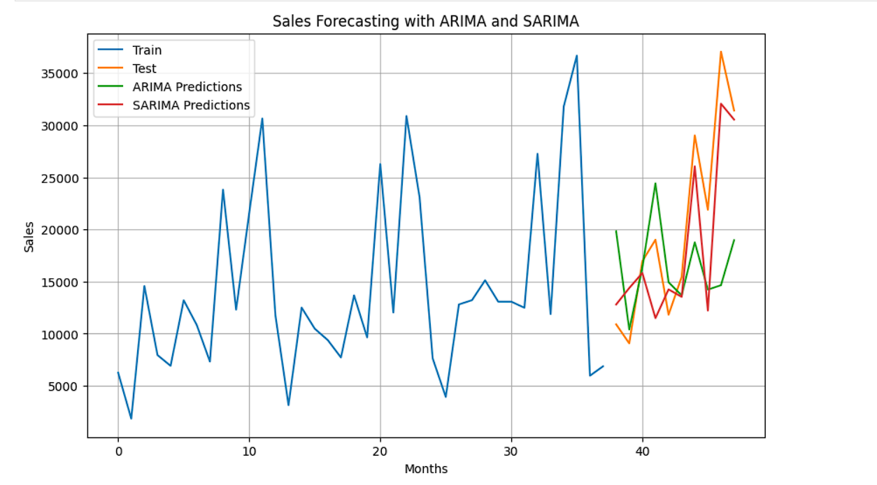
Step - 4 : Testing the both models

Slide 9

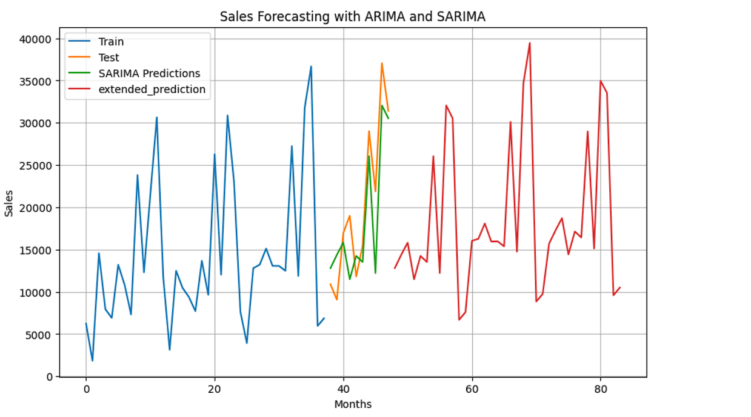
Creating new data for future prediction

